Slide 1
Project 3:
Decentralized Real Estate Marketplace
Charles Panagopoulos, Alex Toenshoff, Samirah Djachechi

Slide 2

Project Summary
Real Estate has made more millionaires than any other industry. However, it is not accessible to everyone. This is why we built a decentralized application to tokenize and invest in real estate.
Decentralization provides more investment opportunities to more people at a lower cost. As blockchain is rapidly spreading across industries, we believe decentralizing real estate is both valuable for long term decentralization.
Being one of the biggest industries in the world, we are confident that creating a DApp for real estate would be a great investment long term.

Slide 3
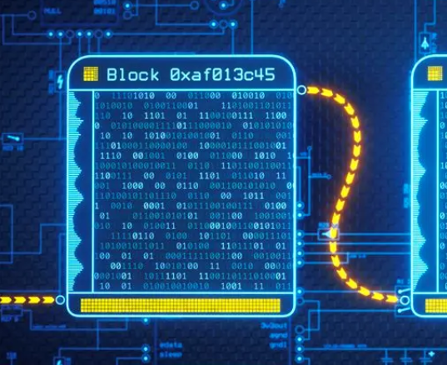
Tokenizing Real Estate Using Smart Contracts
Through our decentralized REIT, we have allowed people to buy shares of real estate, to take advantage of its appreciation during periods of high inflation.
By utilizing smart contracts, we look to simplify ownership disputes across an immutable blockchain ledger.
Smart contracts will also alleviate transaction and legal fees that are notorious in the real estate industry.

Slide 4
Application Core Functionality
Register Properties
Tokenize Property Listings
Appraise & Property Appraisal History
Invest in Properties by Purchasing Shares of Ownership

Slide 5
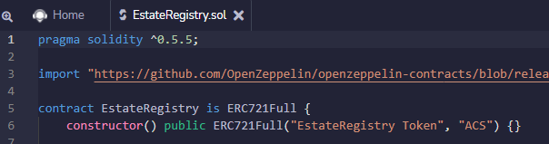
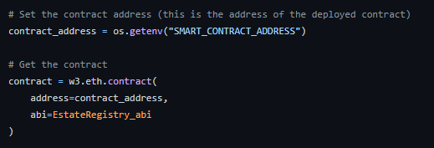
Tools Used for Development
remix.ethereum to code the solidity contract
VScode to house app function using python scripting

Slide 6
Backend:
Solidity Development

Slide 7
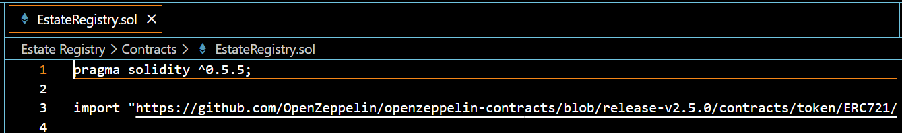
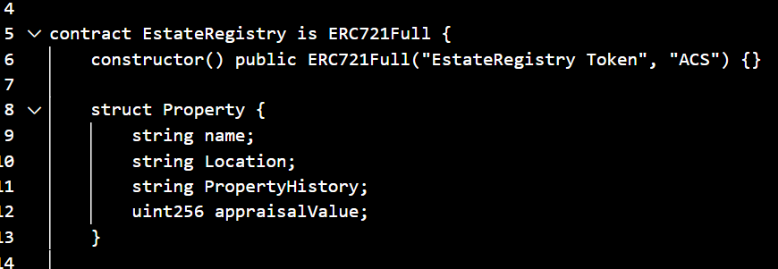
Solidity Contract
Estate Registry ERC 721 Contract Created
Compiler Versioning & OpenZepplin Import
Constructor Function Initialized for Public Token
Property Struct Created to Define Data Types for Property Tokenization

Slide 8
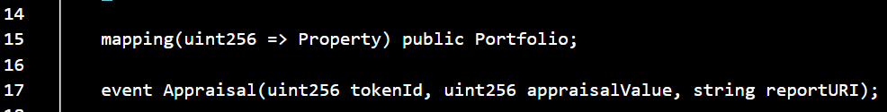
Mapping Property Portfolio
& Appraisal Event Creation

Slide 9
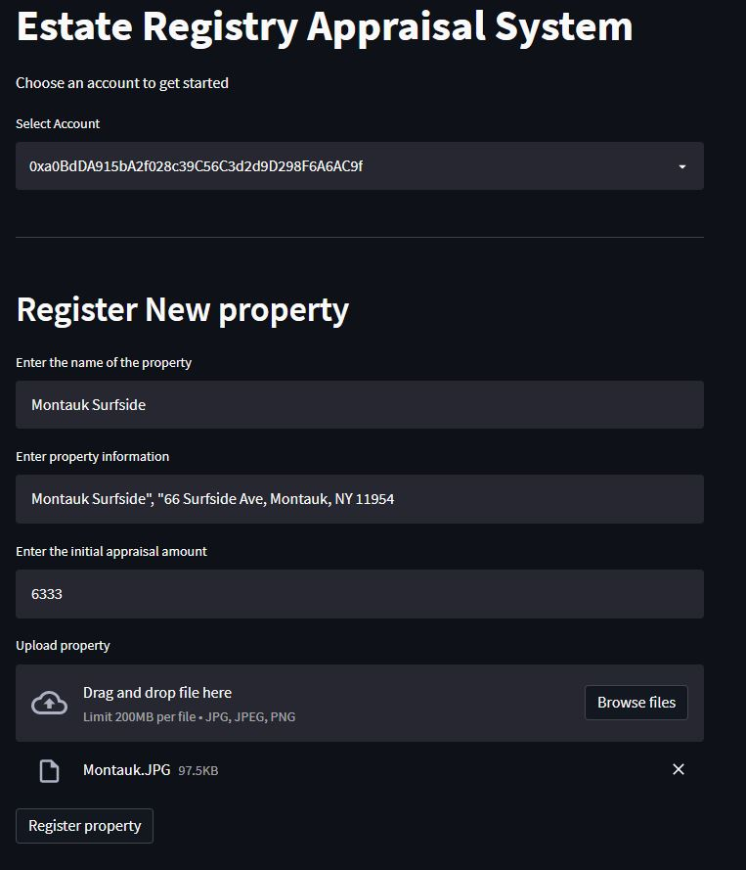
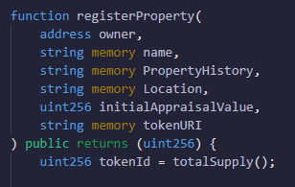
Contract Function and Token Minting
Property Registration defined:
Owner
Property Name
Location
Appraisal Value
Token URI

Slide 10
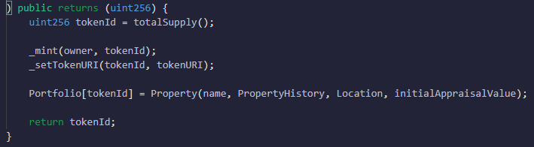
Token Minting & ID Defined
Token minting and token identification defined including token URI
Property tokenization defined

Slide 11
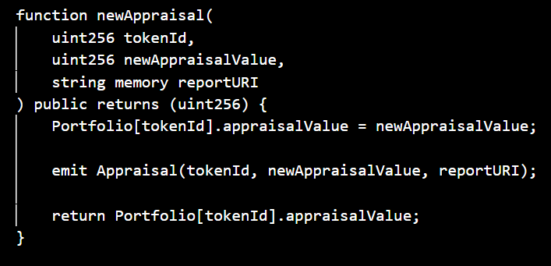
Property Appraisal Function Defined

Slide 12
Frontend:
Python Development

Slide 13
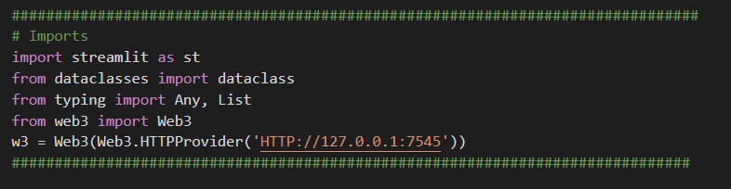
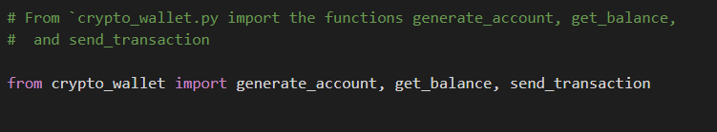
Property App Script: Functions & UI (Streamlit)
Import Dependencies & Libraries
Import Wallet Functions

Slide 14
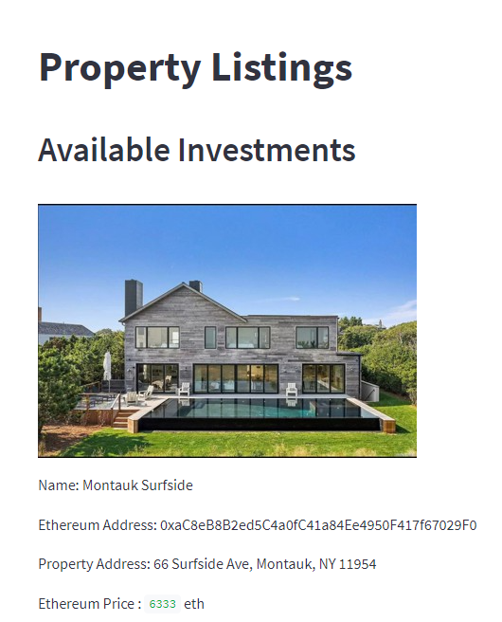
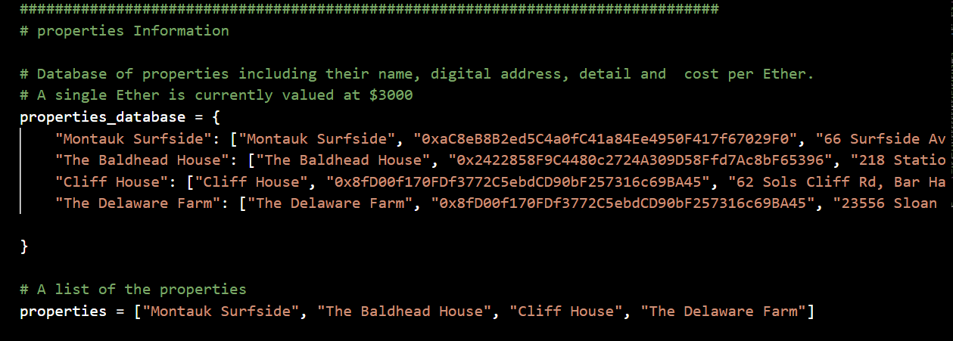
Investment Properties Database Defined

Slide 15
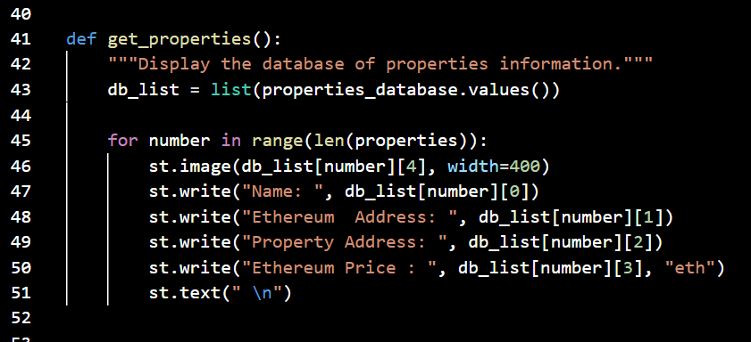
get_properties Function Calls Database Values

Slide 16
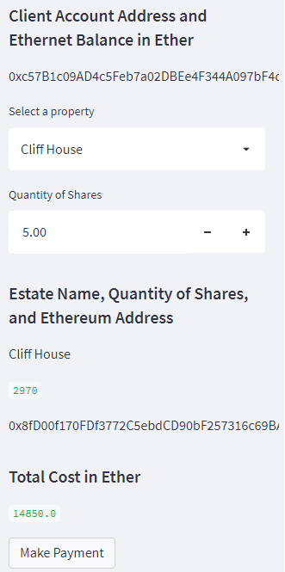
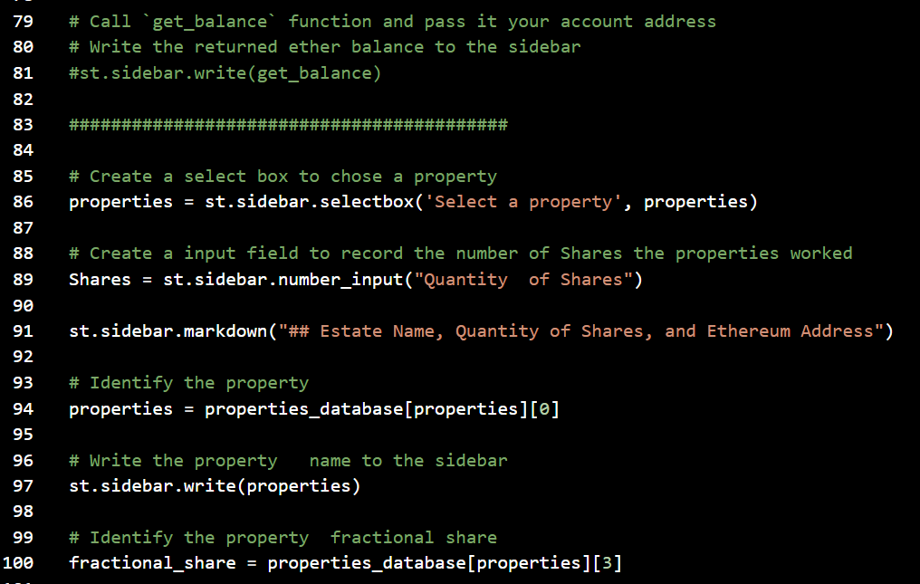
Properties Defined & Written to Streamlit Sidebar

Slide 17
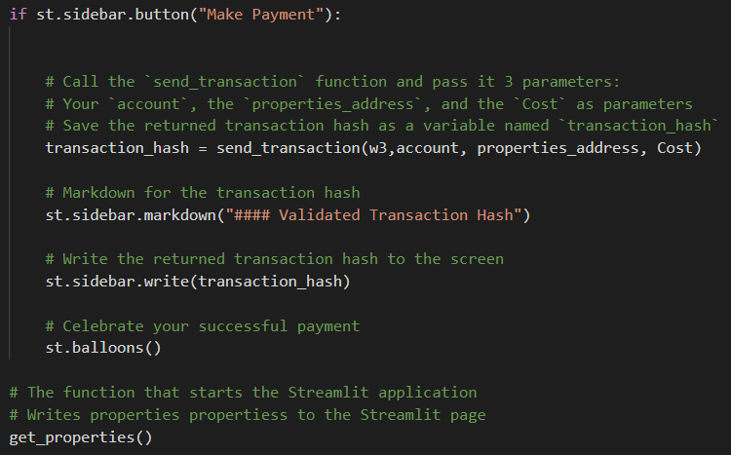
TX Hashing & Payment

Slide 18
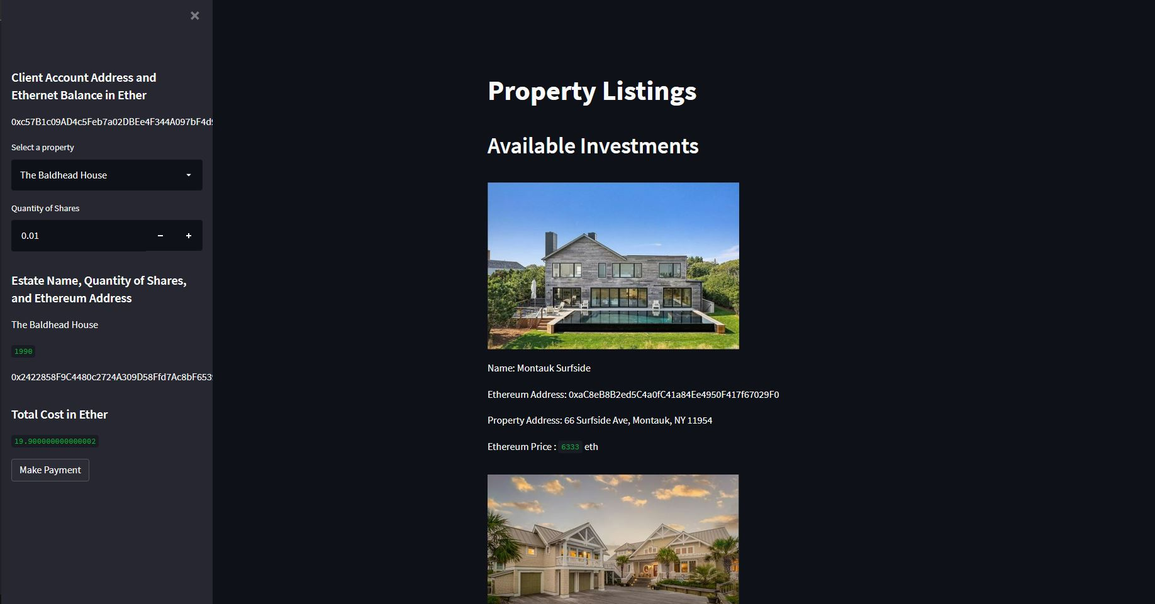
Final Product: Property Listing

Slide 19
Video Demo

Slide 20
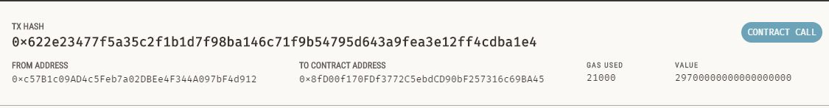
Share Purchase Confirmation on Testnet
(Truffle via Ganache)

Slide 21
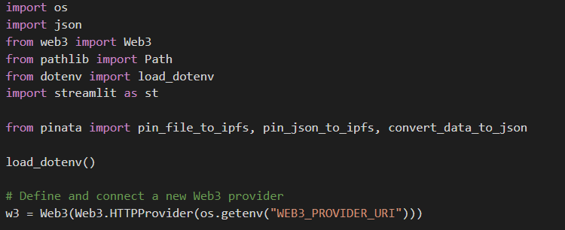
App Script: Property Image Functions w/ Pinata
Dependency & Library Imports

Slide 22
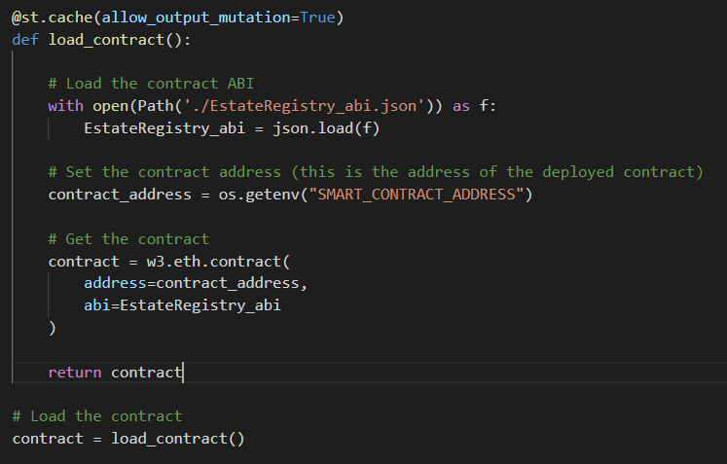
Smart Contract Load Function Defined

Slide 23
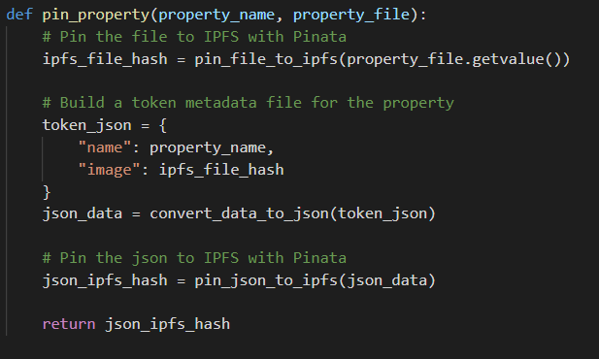
Pin Property Function to
Hash & Convert JSON Data to IPFS

Slide 24
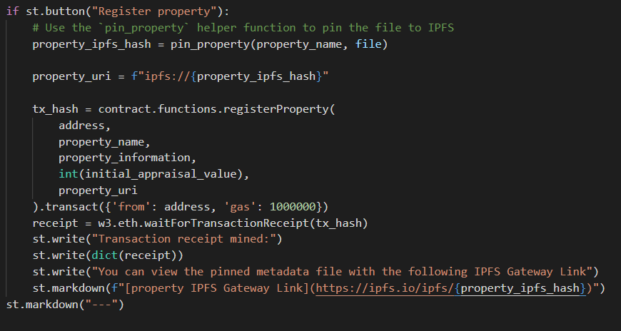
Used Pinata for Property Registration

Slide 25
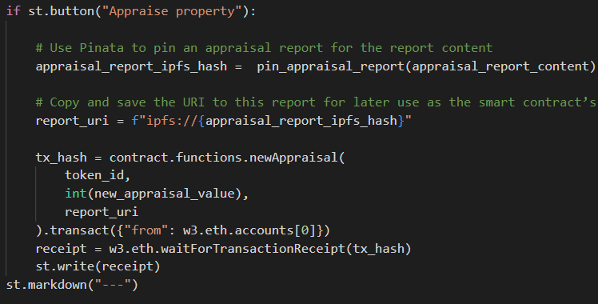
Property Appraisal
Reporting hash defined using IPFS
URI Report Defined
TX Hash Defined
Web3 used to write receipt of TXs

Slide 26
Final Product:
Estate Registry System
Allows new properties to be added to the application and shares can be fractionalized so owners can buy and sell shares.
Owners enter an appraised value of the house and can offer portions of the property for sale.

Slide 27
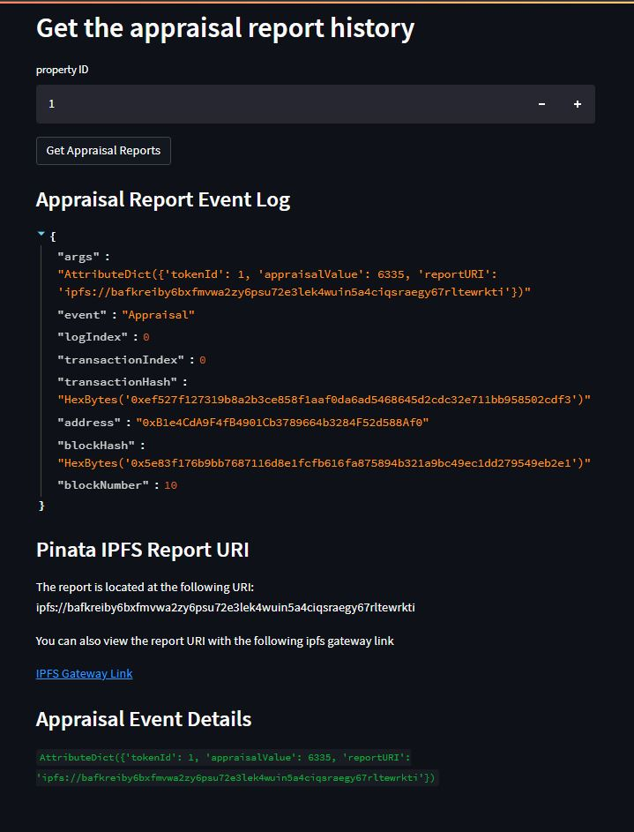
Final Product:
Appraisal History Report
Appraisal History allows investors to see how the property has been appraised in the past, and see if they want to invest in a given property

Slide 28
Video Demo

Slide 29
Thank You

